Slide 1
CUSTOMER CHURN
·PREDICTION·
“ Stay ahead of the game ”

Slide 2

PRESENTED BY ·GROUP 14·
PRESENTED TO ·SIR NAJEEB UR REHMAN·

Slide 3
Group Members
01
SYED ALI HAMZA SHAH
20021519-140
02
MUHAMMAD SHUMILE
20021519-045

Slide 4
· OUTLINE ·
01
02
03
04
PROBLEM
SOLUTION
OBJECTIVES
USER MANUAL

Slide 5
01
· PROBLEM ·
“ The reason from which it all started. “

Slide 6
HIGHER RATE OF CUSTOMER TURNOVER ☹️
A manager at the bank is disturbed with more and more customers leaving their credit card services. They would really appreciate if one could predict for them who is going to get churned so they can proactively go to the customer to provide them better services and turn customers' decisions in the opposite direction

Slide 7
· PROBLEM ·
Reduced customer loyalty and trust
Difficulty in achieving growth targets
Increased marketing and acquisition costs
Decreased revenue and profitability

Slide 8
· SOLUTION ·
02
"The solution lies not in avoiding the challenge, but in facing it head-on with courage, determination, and a willingness to learn and grow from the experience."

Slide 9

01
AI MODEL
Artificial Inteligence Model to predict the customers churn.

Slide 10

CUSTOMER CHURN PREDICTOR
Our model is a machine learning model that aims to predict customer churn for a bank based on customer demographic and credit card usage data. It will use this information to identify which customers are at high risk of leaving the bank's services and provide businesses with insights to take actions to retain these customers and reduce churn.

Slide 11

Our model takes a few inputs to predict the customer’s churn :
Age
Number of dependents
Credit Limit
Total Transaction Amount
Average Utilization Ratio
Then our trained model predicts and gives the user with prediction either it is reliable customer or unreliable customer.

Slide 12
02
CUSTOMERS MANAGEMENT
PyQT Desktop Application to manipulate the customers records.

Slide 13
· FEATURES ·
LOGIN
TABLE
CRUD
CHART
DATABASE
LIST
Provides authentication
Displays all the customers records.
Able to perform CRUD on the customers data, add, delete, edit or update it.
Displays graphical representation.
Storing and retriving the records from the database.
Showing a specific record from the db in list

Slide 14

DATABASE STORAGE
SQLITE Database is the primary storage which is integrated with our application. It provides storage for :
ADMIN :- For admin’s login USERS table is used.
CUSTOMER :- For customer’s data RECORDS table is used.
PREDICTION :- Output of AI Model is stored in PREDICT table

Slide 15
· OBJECTIVES ·
03
“ Providing a sense of purpose and direction ”

Slide 16
· OBJECTIVES ·
Identify at-risk customers
Enable businesses to take actions to reduce churn
Gain practical experience in data analysis and machine learning
Develop an accurate AI model

Slide 17
· USER MANUAL ·
04
“ Understand how to use “

Slide 18
Versatility
Our Desktop App covers a vast concepts of Advance Programming Techniques:
QTable Widget
QTool Bar
QDock Widger
QLayouts
QButtons
QLineEdits
QList Widget
QScroll Bar
QDialog Box
QFrame Widget
QPixMap Widget

Slide 19
AESTHETIC (HCI)
Our Desktop application is user’s friendly interface which allows easy understanding.

Slide 20
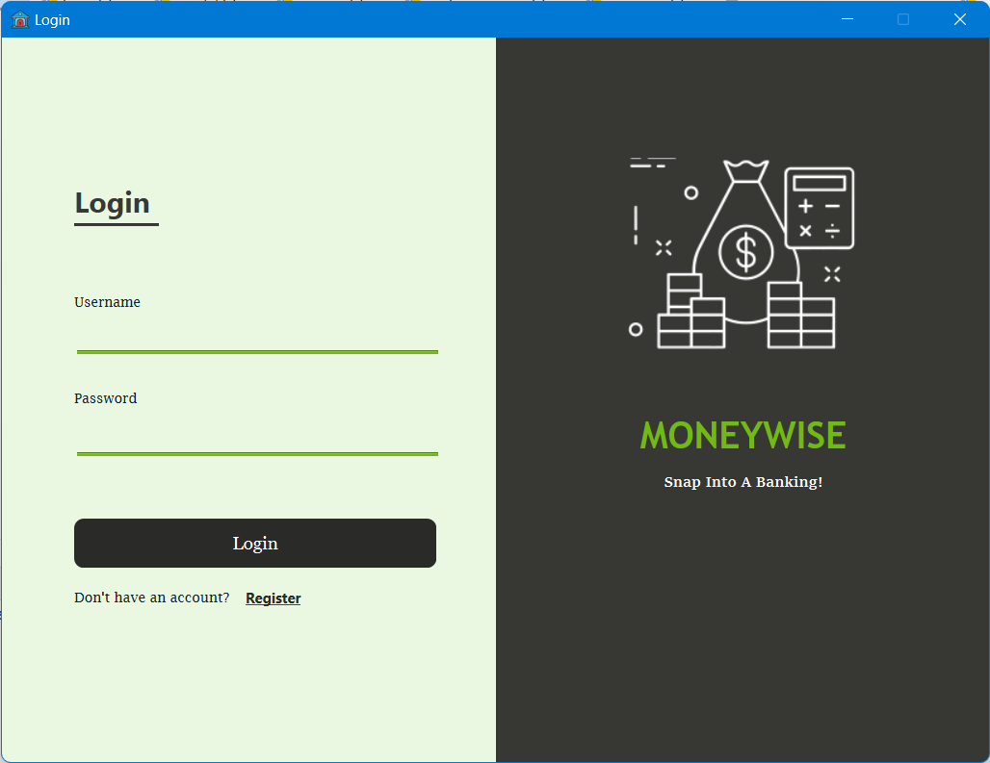

Slide 21
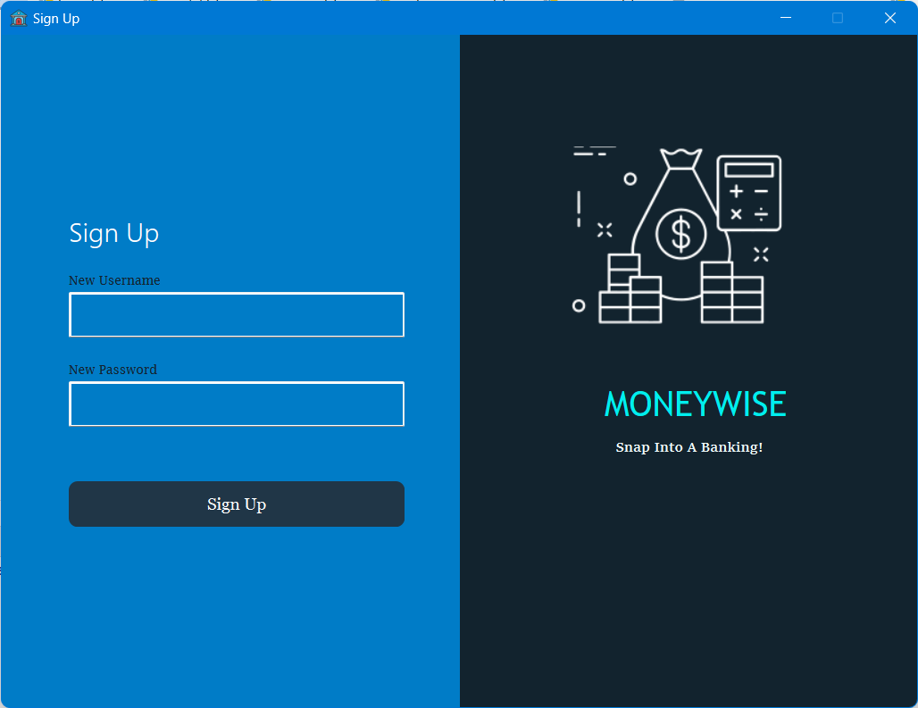

Slide 22
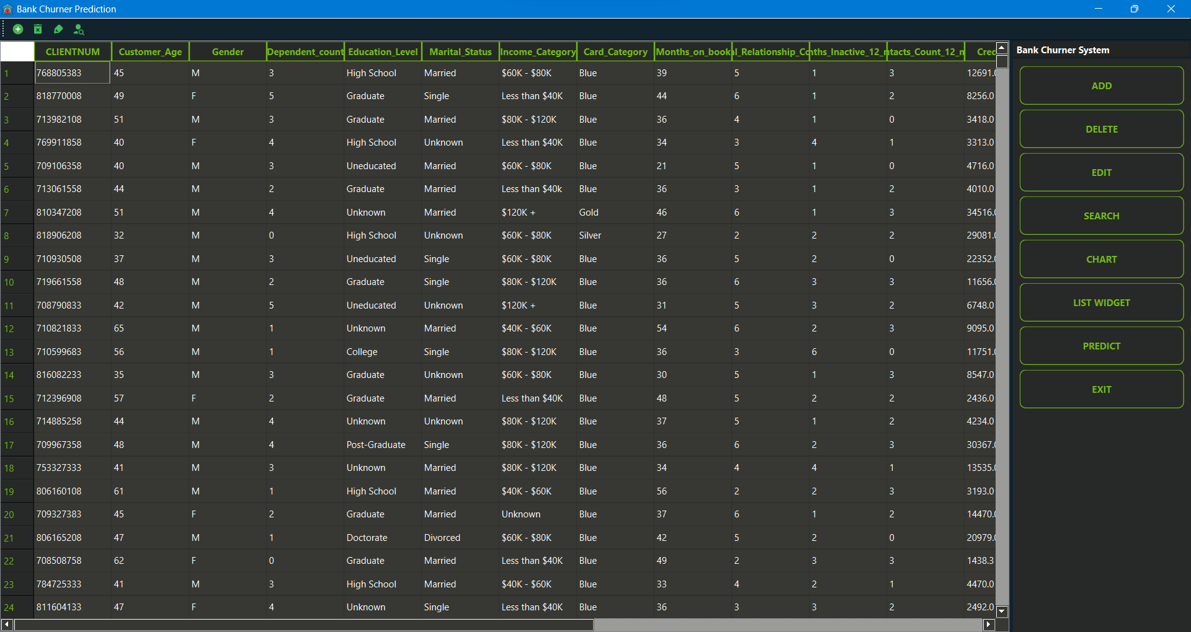

Slide 23
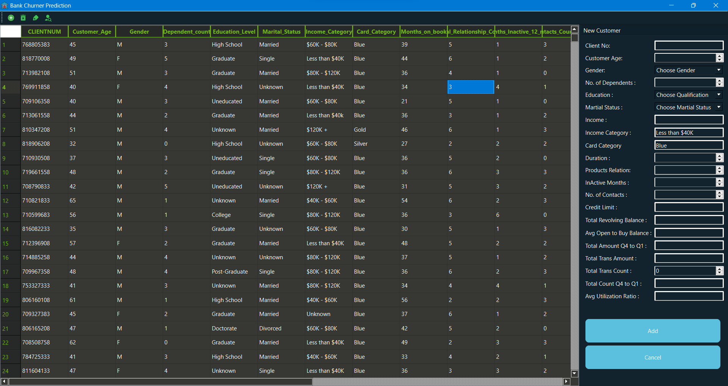

Slide 24
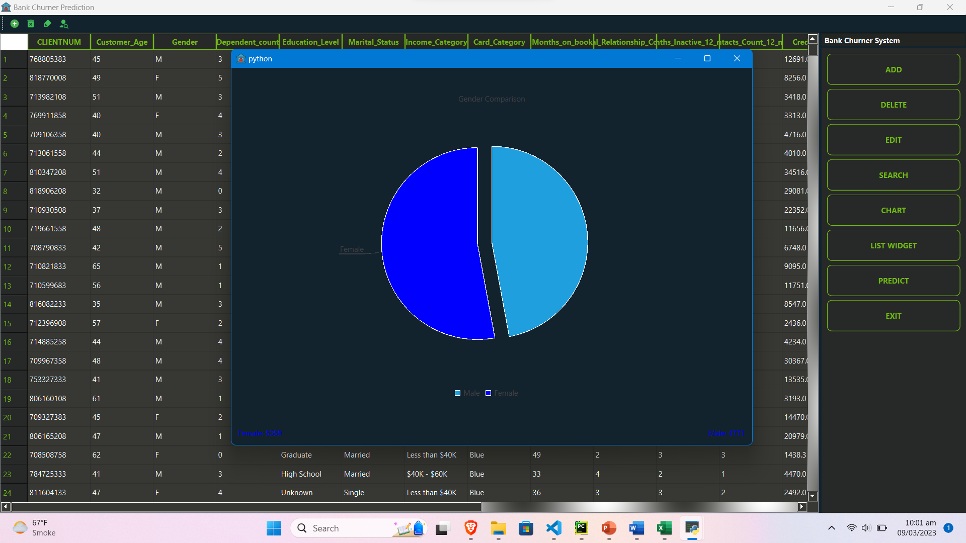

Slide 25
·THANKS·
Do you have any questions?

